Slide 1


Impact of Science Conference the Parallel Session on:
Building Towards Evidence-Informed Policymaking
25th June, 2021

Slide 2


Impact of Science
23-25 June, 2021
David Goldston (Chair) : Director of MIT Washington Office, United States
Patricia Paskov: Analyst in the Impact Evaluation Unit of the Development Research Group, World Bank, USA
Ashraf Bakr Al-Shareef: Consultant in Monitoring and Evaluation (M&E) and the institutionalization of RBM, Egypt
Overview of the Speakers
#IOS21

Slide 3
Impact of Science
23-25 June, 2021
Patricia Paskov
Analyst in the Impact Evaluation Unit of the Development Research Group, World Bank, USA
#IOS21

Slide 4


INNOVATING
PUBLIC ADMINISTRATION
USING DATA
THE WORLD BANK’S BUREAUCRACY LAB
PATRICIA PASKOV
JUNE 2021
June 25, 2021

Slide 5
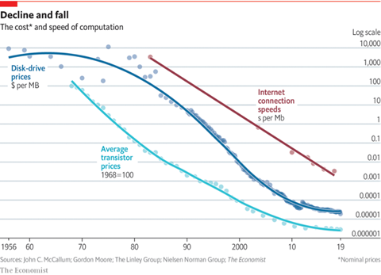
THE DATA REVOLUTION
Notes:
In the past five decades, the world has experienced a data revolution -- an exponential decline in the cost of producing, analyzing, and aggregating data and a substantial increase in the individuals trained in analytical methods to work with that data.
We see this impact in the private sector, where of the ten largest global companies in 2019, 7 were technology companies (World Development Report 2020).
Yet, the public sector lags in the extent to which it harnesses data to inform processes, policies, and procedures.
When harnessed, data lay the ground for improved decision-making, optimized government functioning, and more effective resource allocation in government processes from revenue management and procurement to citizen interface (Hashim and Piatti- Fünfkirchen 2018; World Bank 2016, 2020a).

Slide 6


designing data-driven institutions
The design of public service institutions critically determines the extent to which governments harness data for decision-making (World Development Report 2021):
  Recruiting new personnel
  Building capacities of existing personnel
  Creating teams that embrace empirical culture
  Building incentive environments for innovation
Notes:
The World Development Report 2021 cites the design of public service institutions as a key determinant of how governments harness data for decision-making. In particular, personnel matters. Public service institutions must have personnel with technological skills and data literacy; and must build the incentives for existing personnel to evolve from the status quo towards new data-driven norms.
Recruitment: public administrations in EU-28 countries need an additional 1.7 million employees to address the current skills gap. Governments must recruit personnel that can thread the needle towards empirics.
Training: Given the nature of the public sector, the majority of current public servants will continue to be employed in service for the foreseeable future. Governments must implement training and capacity-building for existing personnel to create cultures of empirics rather than pockets of knowledge.
Teams: as much of public sector work, particularly public administration, is team-based, governments must complement existing expertise with personalities and skills that move public administration towards the use of data (World Development Report, 2021). Tacit knowledge is key in the public sector: personnel make decisions by asking friends and colleagues. So team composition and organizational knowledge matters for decision-making.
Incentives: Personnel respond to the incentive environment in which they work. Traditionally marked by hierarchy and bureaucracy, the public administration introduces different conditions for learning. Institutions and governments that can effectively shift incentive structures to motivate personnel to acquire, absorb and act on new information will be successful in building a data-oriented public sector.

Slide 7

Data for public administration
To promote the
use of data in policymaking,
we must first use data to understand
public administration itself.
Notes:
Who makes up the public administration? What policies foster learning, innovation, reform? While a wealth of data exists within public administrations, very little research exists on the personnel upon whom we rely to systematize the use of data and evidence. In shedding light on who makes up public administrations – and the attitudes, motivations, and characteristics they carry – we can begin to identify opportunities to foster learning, innovation, and reform within the public administration.
In order to engage with and capitalize on data for improved public sector functioning, we must first understand and foster environments in the public administration itself that give way to data for decision-making. In essence, the design of the public sector and the implementation architecture itself must be informed by data.

Slide 8



Slide 9
the Bureaucracy Lab
Innovating public administration through better data and empirics
    Working inside and always with government
    Generating a culture of empiricism for personnel management
    Developing a responsive data and analysis architecture
Notes:
This is precisely the area in which our team at the World Bank’s Bureaucracy Lab works. A joint initiative between operations and research (Government Global Practice (GGP) and Development Impact Evaluation Group (DIME)), The Lab was founded to fill the empirical knowledge gap on public administrations across the world.
At the time, despite their importance, the role of the administrators and managers who are responsible for regulating, financing, and monitoring the work of service providers and other business and citizen-facing public employees was largely a “black box.”
The Lab fused the rigorous data-driven methodologies of DIME with the operational expertise of The GGP to fill this gap, harnessing cutting edge evidence to engender actionable change within public administrations across the globe.
In doing so, we can begin to answer questions on how to reform civil service towards optimal outcomes, including a data-oriented culture.

Slide 10
What do we do?
Worldwide Bureaucracy Indicators
Global Survey of Public Servants
Public employment diagnostics
Productivity assessments
Experimental evidence on reforms
Notes:
Bureaucracy Lab’s work around the world can be broken down into five pillars.
Worldwide Bureaucracy Indicators: we house global benchmarking data on public administration, which provides cross-country insight into the pay, composition, and characteristics of the public sector.
We run public employment diagnostics to understand factors like pay dispersion, wage bills, and their implications on the productivity and future of the public sector.
We house, with partners from Stanford, Nottingham, and UCL, the Global Survey of Public Servants, which gathers granular data on civil servants and managers to understand the attitudes, motivations, and environments of civil servants; completed surveys in over 32 countries.
We run productivity assessments, which reveal a range of insights, including the importance of attitudes, motivations, and factors like performance management on public administration performance.
In Liberia, for example, our data collection in the Forestry Development Authority showed that the quality of management, particularly staff performance evaluations, is a main determinant of staff motivation, yet only a minority of staff had undergone performance evaluations. Such information can inform future directions in management and organization.
We generate experimental evidence on civil service reforms, employing rigorous impact evaluation methodology to provide policy-relevant information.
All of these pillars of work give us a better understanding of the institutions and individuals that make up public administrations; that shape policymaking; and that lie behind the decision to adopt and harness data or forgo the windows of opportunity to become data driven organizations.

Slide 11
QUALITY OF MANAGEMENT VARIES ACROSS ORGANIZATIONS…
Source: 2015 Ghana Civil Servants Survey
Notes:
An example of survey and diagnostic work: as part of a baseline diagnostic, the Bureaucracy Lab and its partners audited more than 7,000 quarterly and annual progress reports and surveyed about 3,000 civil servants across 47 central Ministries, Department, and Agencies (MDAs) in Ghana throughout 2015. The data revealed four interesting facts: (i) the quality of management across and within organizations explains much of the variation in productivity; (ii) the Ghanaian civil service is characterized by substantial heterogeneity in productivity across and within organizations; (iii) civil servants demonstrated constraints in their ability to resolve problems, showing a disconnection between identifying problems and practical knowledge of how to tackle them; and (iv) public officials were not satisfied with the currently provided training programs.

Slide 12
…AND PRODUCTIVITY DOES TOO.
Source: 2015 Ghana Civil Servants Survey

Slide 13
Experimentation FOR INNOVATION
Generating operational, problem-driven, iterative, counter-factual evidence to:
  Identify causal relationships between reforms and outcomes
  Provide precise and actionable answers
  Help managers make more informed decisions about programs and policies
Notes:
A key pillar, experimentation, can follow diagnosis to provide policy recommendations. We combine baseline and endline surveys; administrative data; and real time analytics to measure productivity and test new reforms in novel and frontier ways. Each step of this effort transforms our ability to diagnose, design and evaluate effective civil service reforms in areas like training, recruitment, and institutional change towards empirics; provide precise an actionable answers; and apply those answers towards policy and decision-making.

Slide 14
CAPACITY-BUILDING IN GHANA
Program: Training for Productivity, in collaboration with the Ghanaian Head of Civil Service (OHCS)
Data: 3K civil servant surveys across 58 agencies; 10K progress report audits
Results: improved quality of management, strengthened government processes, new monitoring system for training, agency-specific reforms
Notes:
Bureaucracy Lab, University of Oxford, and University College London then worked closely with the Ghanaian Head of Civil Service (OHCS) to implement a civil service productivity training program as a response to 2015 the diagnostic findings. It aimed to improve senior officials' skills and working competencies by introducing a new productivity training program based on applied productivity techniques and teamwork learning experiences. The new curriculum was included in individual in-service training, the Scheme of Service training (SoS), throughout 2017, randomizing whether civil servants received the new or the standard training curriculum.
The results of the second wave of data collection in 2018 showed that the quality of management had slightly improved from 2015 to 2018, and that the training had significantly strengthened government processes. The preliminary results were presented in various dissemination events to further support the reform process. Moreover, the Bureaucracy Lab team coordinated ministry-specific presentations, highlighting the areas of strength and weakness of each 58 MDAs the team worked with.
Following the dissemination events, the ministry-specific reports generated internal reforms towards boosting performance in those managerial areas where specific MDAs they felt short. Among them, the Ministry of Youth and Sports (MOYS) has (i) institutionalized attendance records for senior staff, junior staff, and sub-professional staff to capture attendance rates; (ii) established regular directorate meetings to discuss challenges and implementation of departmental action plans and (iii) linked directorates deliverables with job schedules of staff, as a base for their performance appraisals.

Slide 15
EU public administration productivity
Launched in 2019 in collaboration with the Directorate General for Regional & Urban Policy (DG-REGIO) and Structural Reform Support Service (SRSS) of European Commission (EC)
Objectives:
    Implement impact evaluations on civil service reforms to guide decision-making
    Conduct civil service surveys to build cross-country personnel data across EU countries
    Use administrative, real-time, and survey data to reveal insights on the determinants of public sector productivity
Notes:
EU Measuring and Evaluating Determinants of Public Administration Productivity is a collaboration between the Directorate General for Regional and Urban Policy (DG-REGIO) and Structural Reform Support Service (SRSS) of European Commission (EC) and The World Bank’s Bureaucracy Lab. The project works with EC Member States to test the effectiveness of new public administration reforms via impact evaluations, develop indicators of public administration productivity, and conduct data collection within the public administration. The project is founded upon the idea that better data can help to identify constraints, generate evidence on the effectiveness of reforms, and facilitate cross-country comparisons.

Slide 16
EU public administration productivity
Country | Status | Counterpart | Topic
Estonia | In implementation | Ministry of Finance | Improving government accountability through a civil service dashboard
Slovakia | In implementation | Ministry of Interior | Evaluating district office management and productivity
Lithuania | In implementation | Ministry of Health, Ministry of Education, Policy Lab | Fostering co-production in the service delivery chain of youth mental health
Italy | In proposal | In proposal | Modernizing recruitment methodologies
Romania | In proposal | Institute of National Administration | Capacity-building through applied productivity training

Slide 17
PERFORMANCE DASHBOARDS in Estonia
Partner: Ministry of Finance
Program: local government performance dashboard with over 300 indicators across 79 local governments and 15 sectors
Outcomes: public official performance, citizen demands, official-citizen interactions
Panel data: 2.4K civil servants across 79 agencies
Notes:
World Bank’s Bureaucracy Lab is working closely with the Ministry of Finance in Estonia to evaluate a local government performance dashboard on accountability, performance, and citizen engagement.
The European Commission has pointed out in its yearly country specific recommendation that the quality of services provided by Estonia’s local governments varies substantially. Civil society and the central government have committed, under the Open Government Partnership, to create a webpage with over 300 indicators to compare local government service levels. The indicators span 79 local governments and 15 sectors including housing, education, waste management, and culture, among others. It is hoped that this will create a ground for discussions on what are the society’s expectations on service levels across the country, what are the differences in these levels that are acceptable, and what should be changed. This aims to increase local governments’ accountability and nudge them to provide better services and make their processes more effective. It also enables the central government to better target its intervention instruments.

Slide 18
Thank YOU for your attention.
ppaskov@worldbank.org
June 25, 2021

Slide 19
INFORMATION PROVISION IN ETHIOPIA
Source: 2015 Ethiopia Civil Servants Survey
Notes:
How well informed are public officials in Ethiopia? What makes some public officials more informed than others? To better provide answers to these questions that were of substantial importance to the Ethiopian Government, we developed an impact evaluation in 2015.
The impact evaluation was the first study, to our knowledge, that measures the individual-level information that public officials hold. We developed an innovative survey instrument to assess the accuracy of information that civil servants have on their constituencies. By comparing the responses of these officials to administrative and survey data on the same variables, we are able to assess the 'noise' in official's beliefs. We found that civil servants make extremely large errors across the range of policy domains, including even the number of citizens that they serve:
16% of officials over or underestimate the number of citizens that they serve by more than the population of the `typical’ district (they are an entire district away from the benchmark data!).
47% of officials claim that their district’s population is 50% bigger or smaller than it is.
Before the survey, we sent a data briefing to a random subset of officials to assess whether such briefings can improve the quality of information in the civil service. The briefings led to large and significant improvements in the information held by public officials.
Interestingly however, the effects of the briefings were significantly mitigated by organizational incentives. As the figure shows, the briefings had the largest impacts where management practices around information acquisition were weakest.

Slide 20
Impact of Science
23-25 June, 2021
Ashraf Bakr Al-Shareef
Consultant in Monitoring and Evaluation (M&E) and the institutionalization of RBM, Egypt
#IOS21

Slide 21

Evidence-Based Policymaking:
A New Global Divide?
Ashraf Bakr Al-Shareef, PhD
RBM/M&E Consultant
The Transformative Power of Research
Cape Town, South Africa
23 – 25 June 2021

Slide 22
This presentation
Observations re: efforts, initiatives, and progrss towards evidence-based policymaking
Two cases of recent national policymaking from the MENA region
An overarching question for discussion

Slide 23
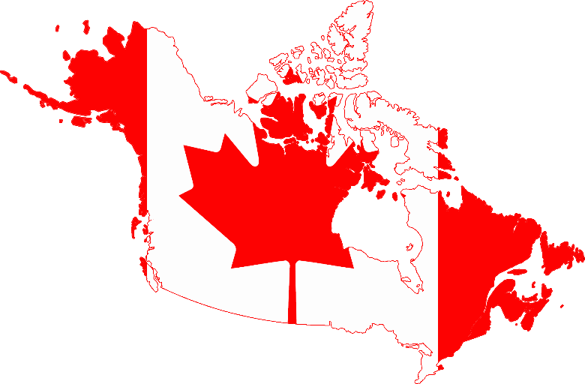
Canada
1969: formal, centralized evaluation practice
Revisions and updates
1991
2001
2009
2016
Policy for Results

Slide 24
Canada
Internal Evaluation Units in most federal departments, with central leadership
Emphasis on both monitoring and evaluation
Well defined rules and expectations for performance management and evaluation
Formal requirements for using M&E information in government

Slide 25

USA
Foundations for Evidence-Based Policymaking Act of 2018
  A systematic plan for identifying and addressing policy questions:
    Questions for developing evidence to support policymaking;
    Data to be collected, used, or acquired to facilitate the use of evidence in policymaking;
    Methods and analytical approaches that may be used to develop evidence to support policymaking; and
    Challenges to developing evidence to support policymaking.

Slide 26
USA
  For every major federal agency:
    Evaluation Plan;
    Evaluation Officer;
    Chief Data Officer;
    Chief Information Officer;
    Chief Performance Officer; and
    Advisory Committee on Data for Evidence Building “to review, analyze, and make recommendations on how to promote the use of federal data for evidence building.”

Slide 27
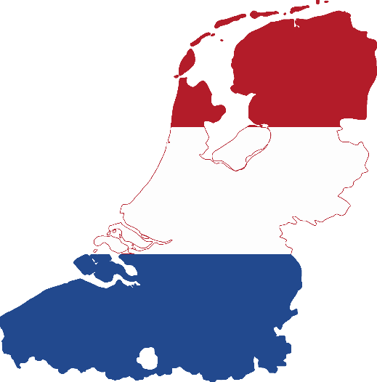
Netherlands
Government Accounts Act 2016; Section 3.1
  “proposals, intentions and undertakings” submitted by ministries to the parliament for financing and approval “contain explanatory notes detailing:
    the objectives, effectiveness and efficiency they seek to achieve;
    the instruments used for this purpose;
    the financial implications for central government and, where possible, the financial implications for other sections of society.”

Slide 28

United Kingdom
What Works Network, 2013
  “to ensure that spending and practice in public services is informed by the best available evidence”
  Policy areas include health, education, local economic growth, children’s social care, …
  More than £250 billion of public spending

Slide 29
The UK
  Advice to ministers and civil service leaders on what evidence shows to be cost effective in delivering policy outcomes, drawing on the findings of the What Works Centres;
  Cross-Government Trial Advice Panel, providing a free advisory service to civil servants to test the efficacy of policies and programmes;
  Supporting civil service with the skills and commitment to use evidence effectively by providing training and technical support.

Slide 30
Trans-country Initiatives
AESIS Network: The Network for Advancing and Evaluating the Societal Impact of Science
APEA: Asia-Pacific Evaluation Association
AfrEA: African Evaluation Association
EvalMENA: The MENA Evaluators Network

Slide 31








Globally
2002
2003
2008
2011
2013
2015
2020
2015

Slide 32
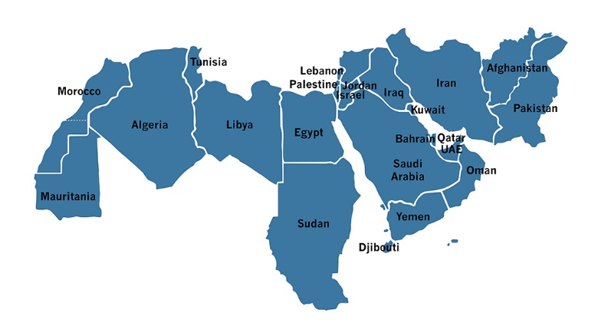
Case 1
2018: Complete overhaul of pre-university education
  25 million students
  1.6+ million employees
No diagnostics; no situational analysis
Closely-guarded “vision for reform”
No clear implementation plan
No M&E framework or practice

Slide 33
Case 2
Merger of agriculture, water and environment into one ministry
Three international consortiums:
  Independent strategy and implementation framework for each “sector”
  Secondary “official” data
  List of KPIs
Ad-hoc, parallel “Office” for monitoring

Slide 34
Is it only “developing” countries?
June 2017: US withdrawal from the Paris Agreement
  Global warming is a “hoax”
February 2021: US re-joins Paris Agreement
Amazon forests massive deforestation
Response to COVID-19
  US, Brazil, Tanzania, …

Slide 35
There is a global gap!
“Globally, 91 percent of countries’ national development strategies—approved since 2015—refer to the 2030 agenda and the Sustainable Development Goals (SDGs); however, according to the Global Partnership for Effective Development Co-operation, only 35 percent of them have reliable data and systems to track the progress of their policies and programs.”
https://www.globalevaluationinitiative.org/about-gei

Slide 36


My question
As we face existential threats, can we afford a new global divide?
  How can we move from supply-driven to demand-driven model(s)?
    The political winds!

Slide 37
Impact of Science
23-25 June, 2021
Thank you
#IOS21

